Slide 1

Sell to the
most likely
buyers
“as-is”
Hassle-free
Complimentary
advice and
evaluation
2%
Commission
Is your property a candidate for redevelopment?
infillRE, LLC 53 Ogden Ave. Clarendon Hills Illinois 60514
630-654-4100 info@teardowns.com

Slide 2
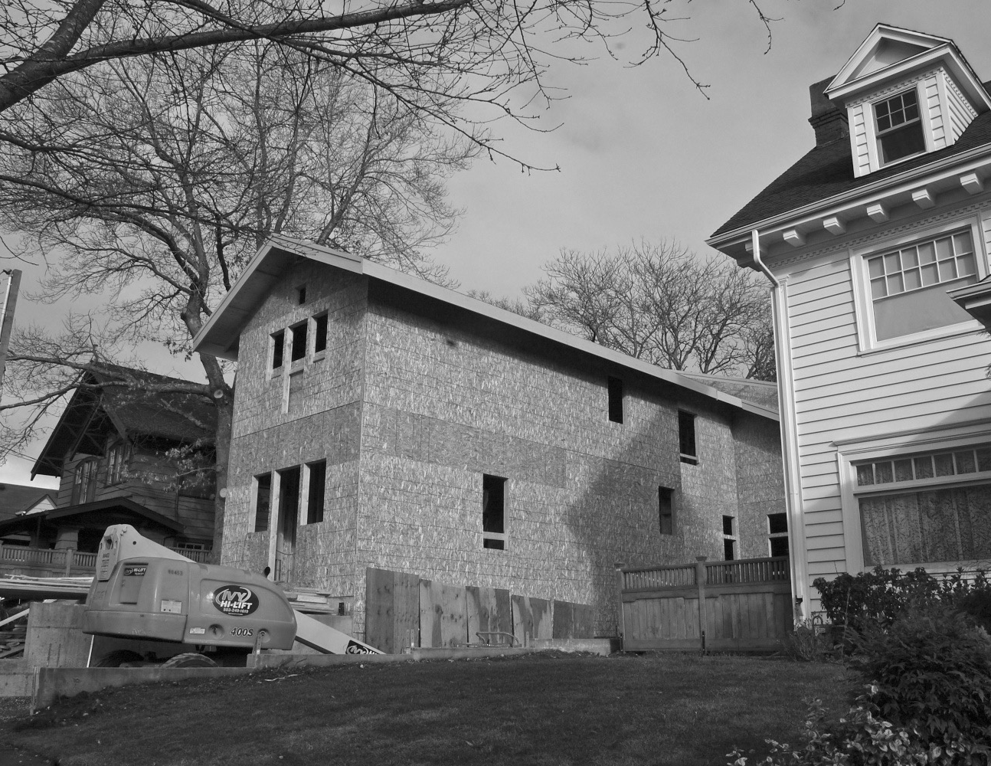

Sell to the
most likely
buyers
“as-is”
Hassle-free
Complimentary
advice and
evaluation
2%
Commission
The Marketplace for teardowns and rehabs
infillRE, LLC 53 Ogden Ave. Clarendon Hills Illinois 60514
630-654-4100 info@teardowns.com

