Slide 1

The Marketplace for teardowns and rehabs
Hassle-free
Sell to the most likely buyers “as-is”
Complimentary advice and evaluation
2% Commission
infillRE, LLC 53 Ogden Ave. Clarendon Hills Illinois 60514
630-654-4100 info@teardowns.com

Slide 2
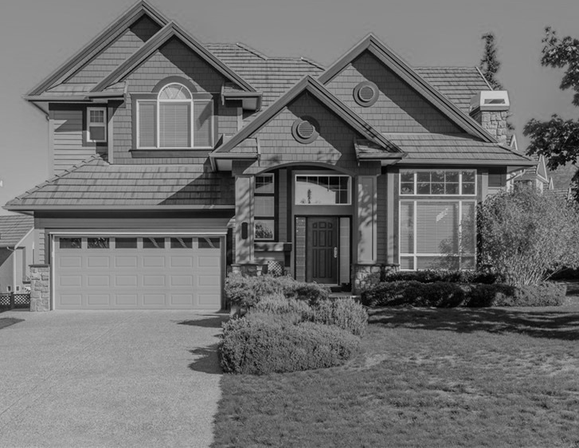

Is your property a candidate for redevelopment?
Hassle-free
Sell to the most likely buyers “as-is”
Complimentary advice and evaluation
2% Commission
infillRE, LLC 53 Ogden Ave. Clarendon Hills Illinois 60514
630-654-4100 info@teardowns.com

